Slide 1

Istanbul Medipol University Business School Management Information Systems Department MIS4112149 DATA MINING AND BUSINESS INTELLIGENCE Lecturer Nada Misk
Final Assignment
by HSNB Project Team

Slide 2






DATASET
Top 1000 IMDb Movies
This comprehensive collection presents the most celebrated and beloved movies, as rated and ranked by IMDb users.
https://www.kaggle.com/datasets/inductiveanks/top-1000-imdb-movies-dataset

Slide 3
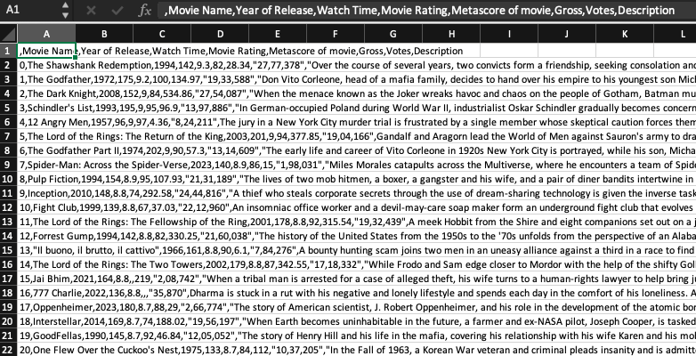
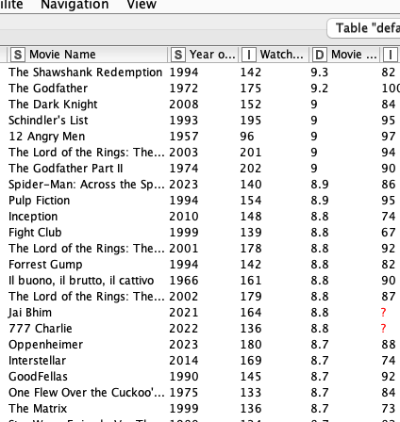


Slide 4
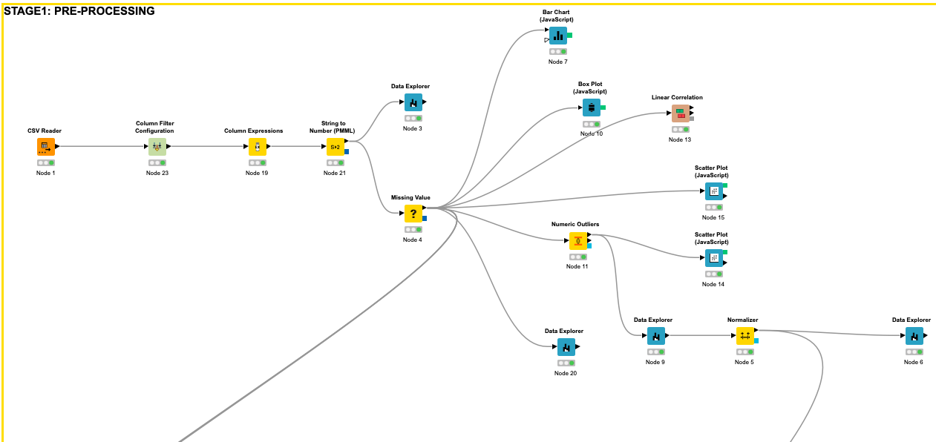
Pre-processing

Slide 5
Pre-processing

Slide 6
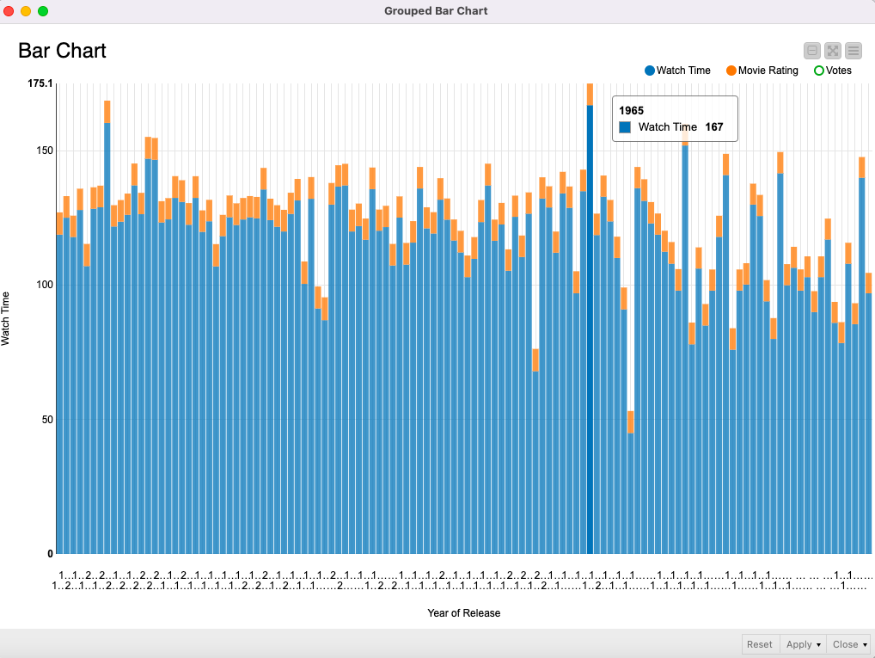
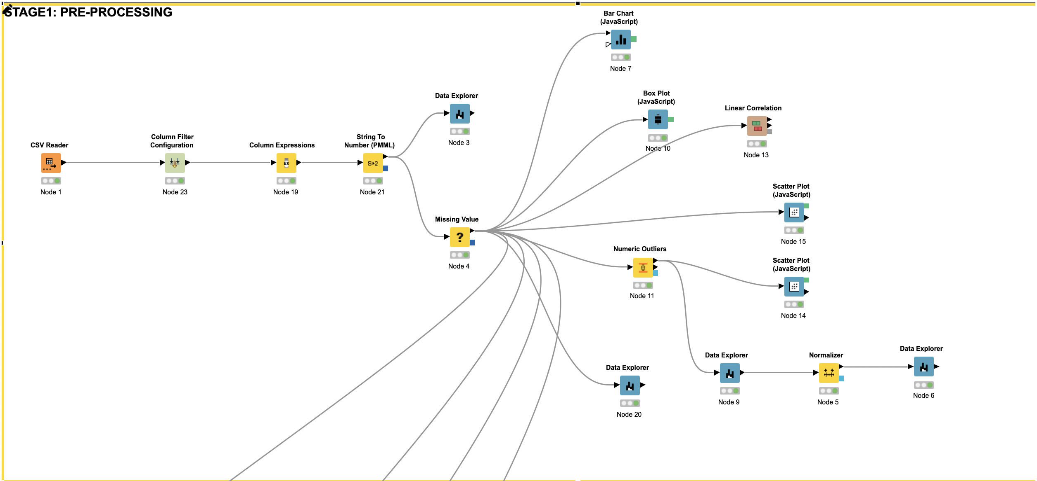
Pre-processing

Slide 7
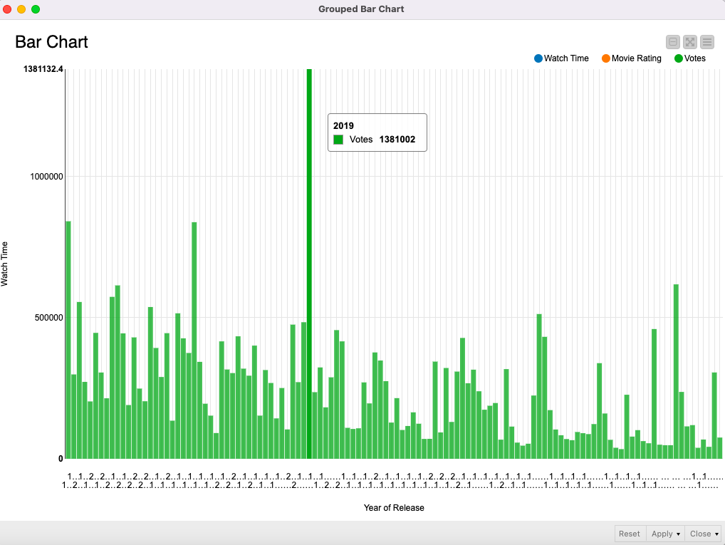
Pre-processing

Slide 8
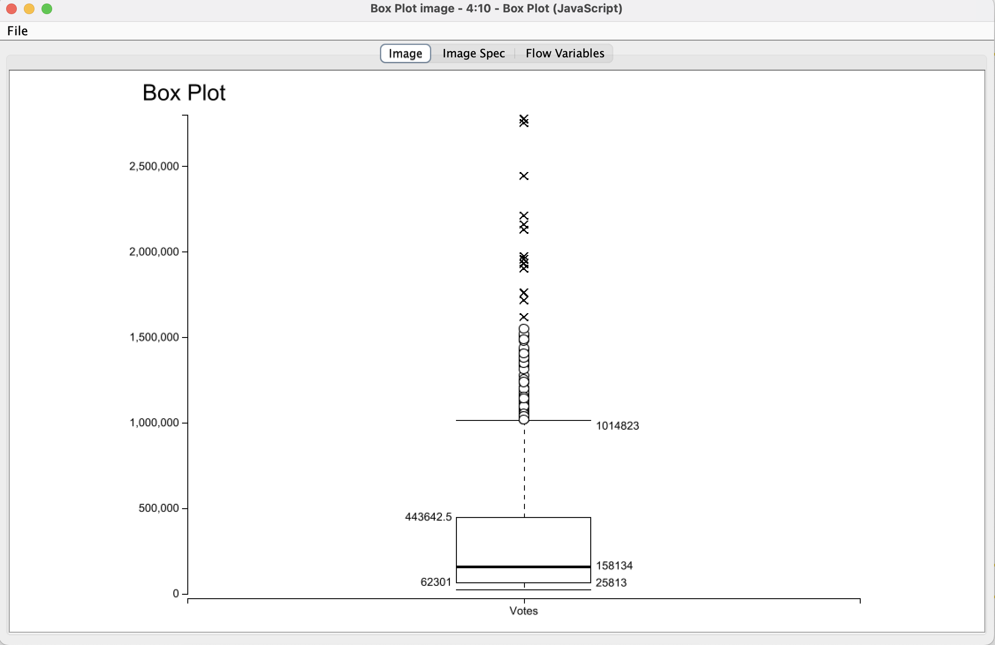
Pre-processing

Slide 9
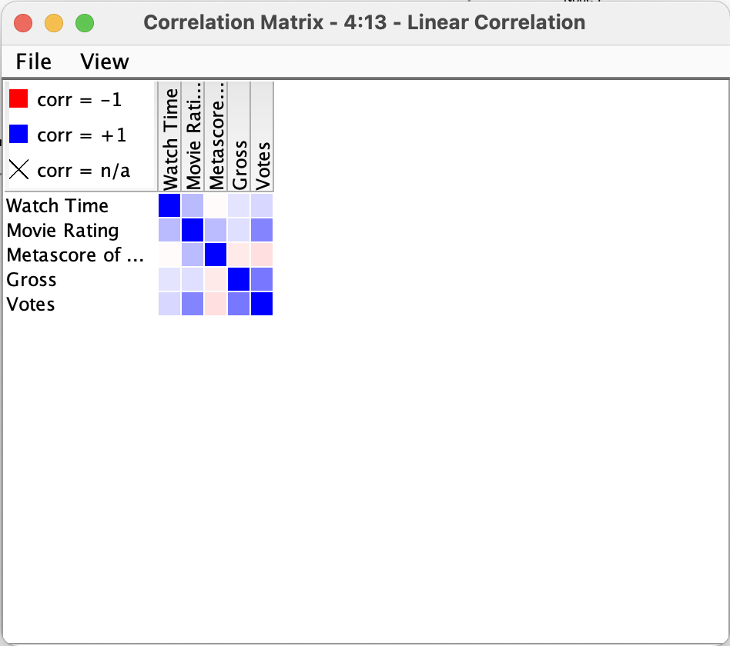
Pre-processing

Slide 10
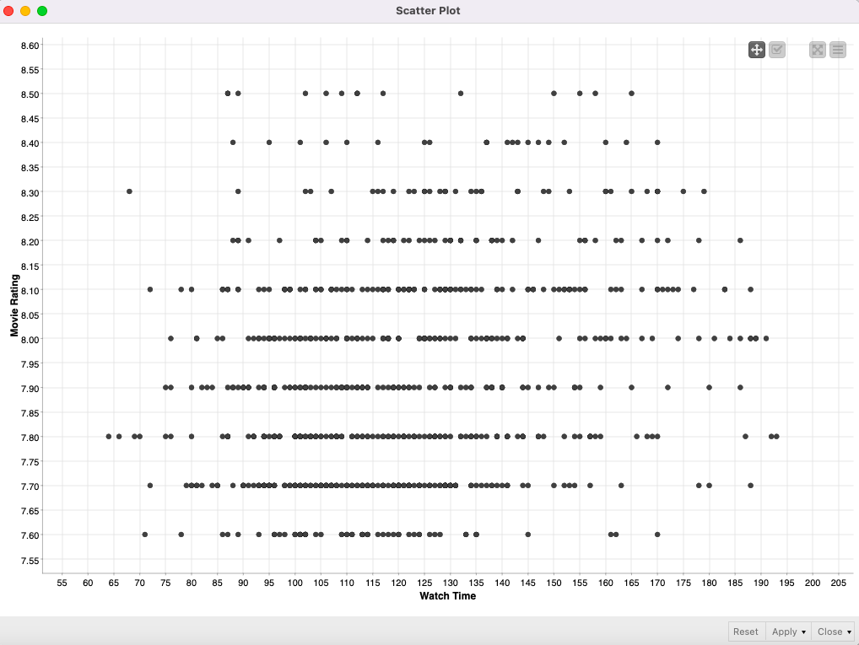
Pre-processing

Slide 11
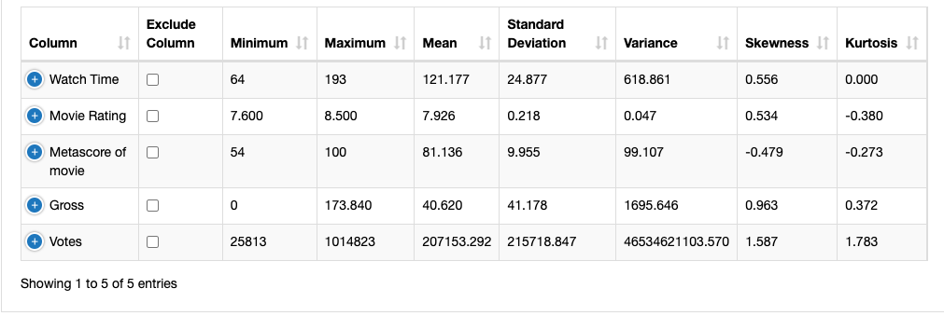
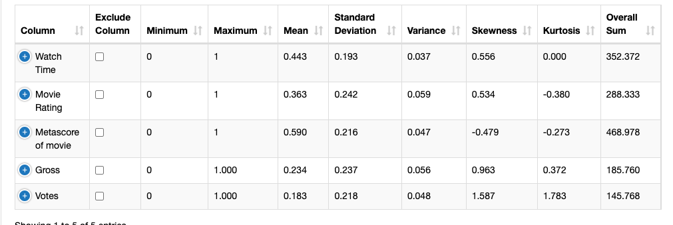
Pre-processing

Slide 12
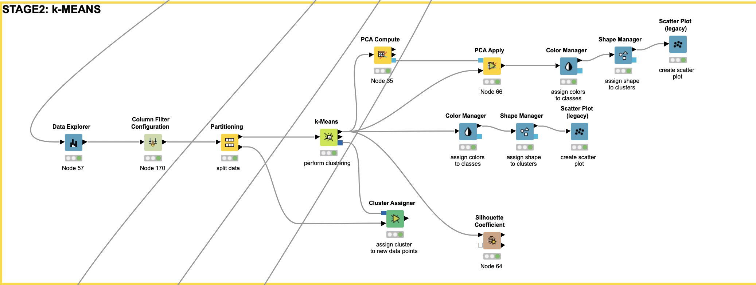
K-Means

Slide 13
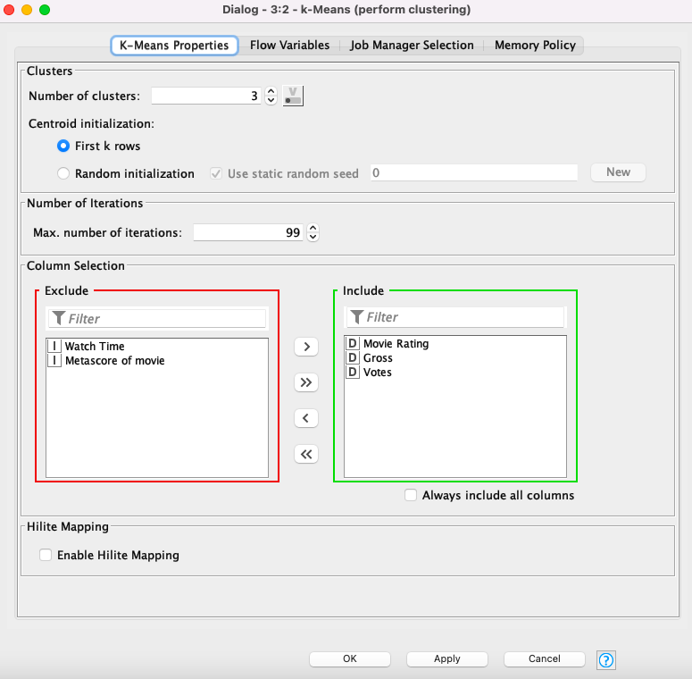
K-Means

Slide 14
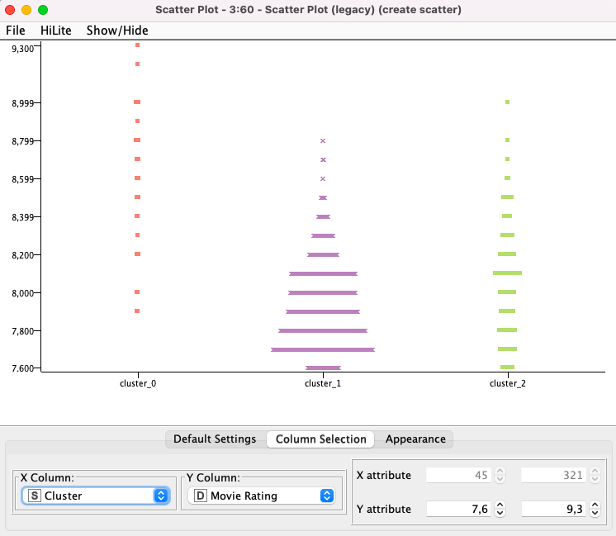
K-Means

Slide 15
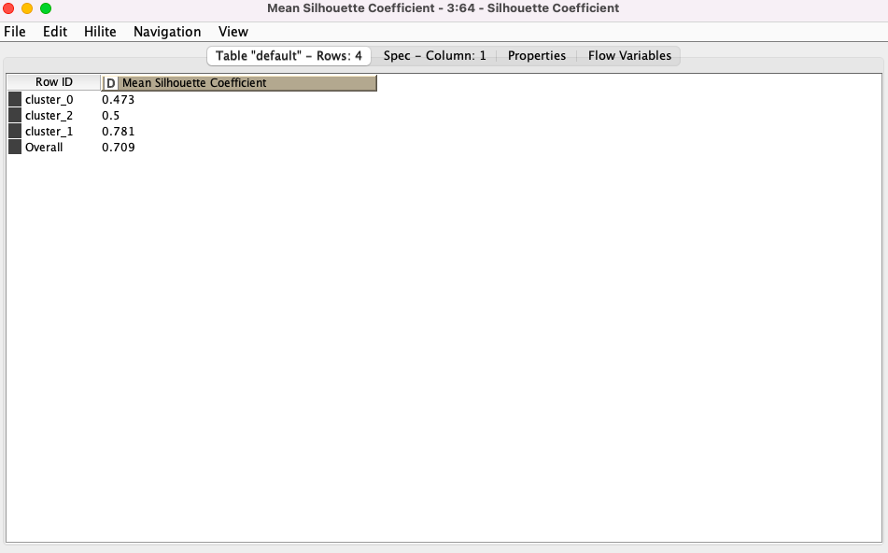
K-Means

Slide 16
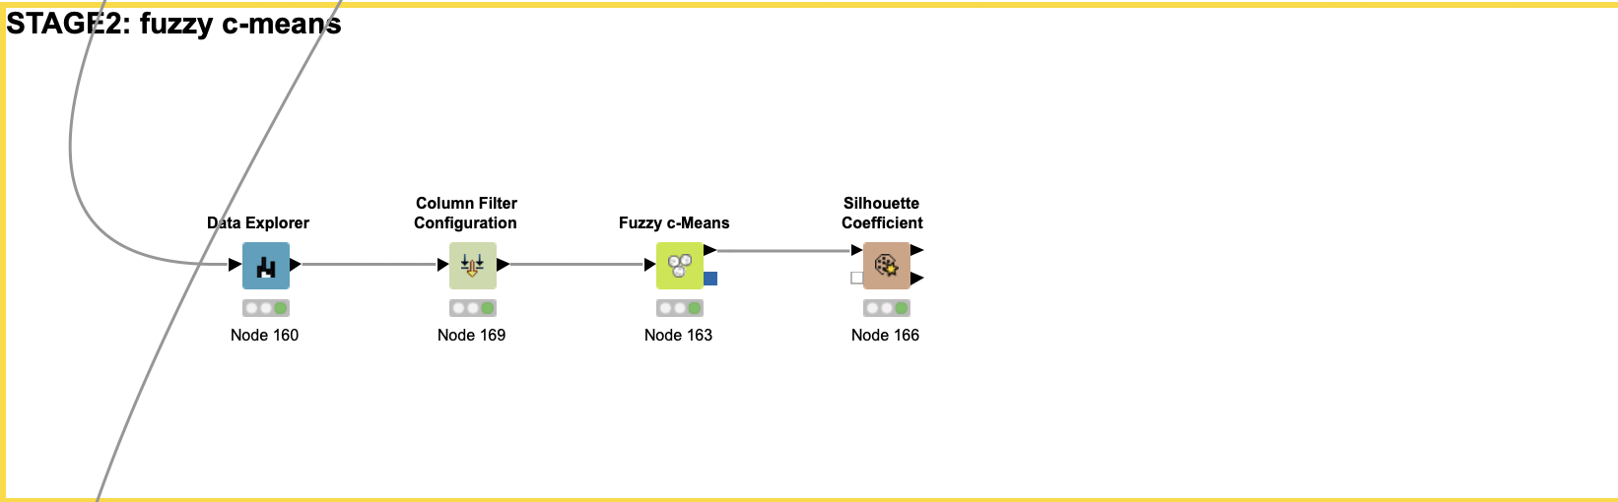
Fuzzy C-Means

Slide 17
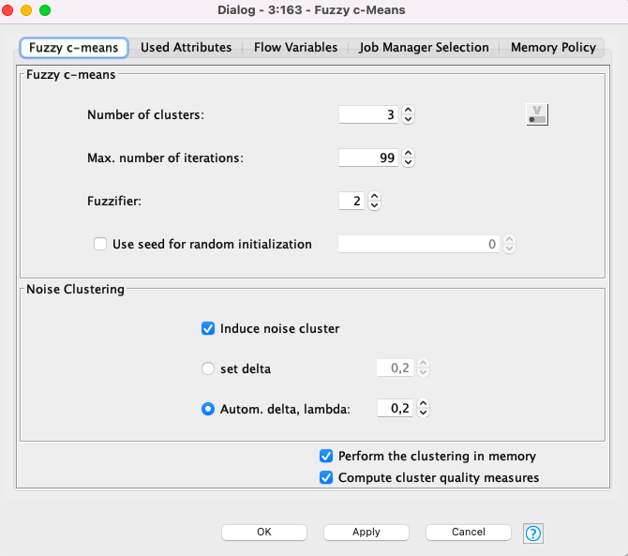
Fuzzy C-Means

Slide 18
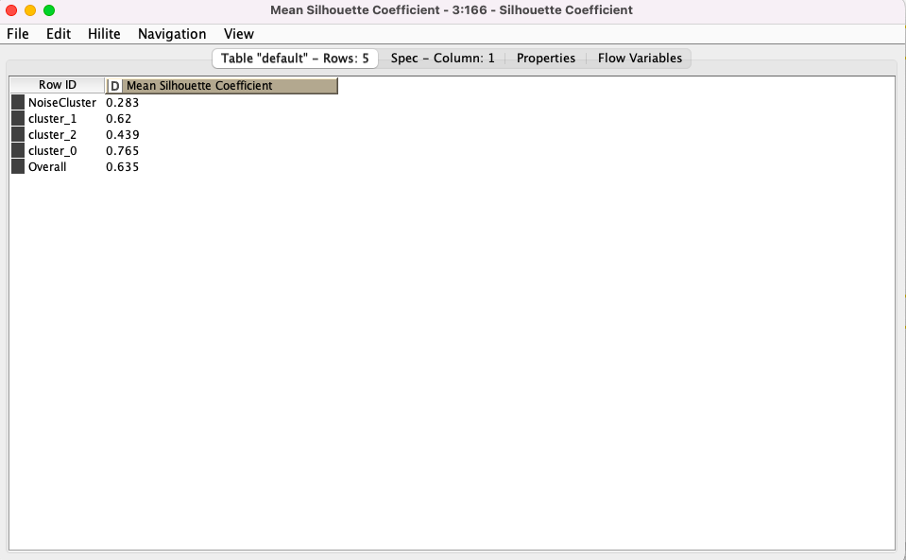
Fuzzy C-Means

Slide 19
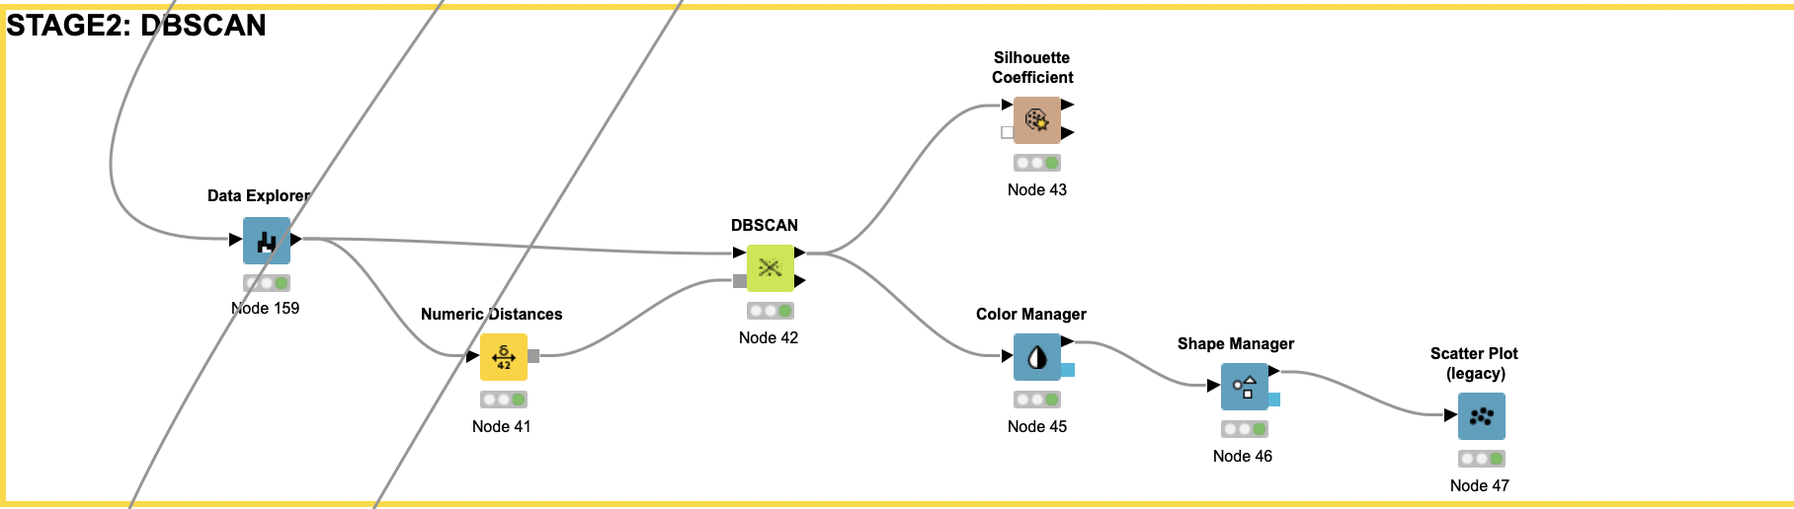
DBSCAN

Slide 20
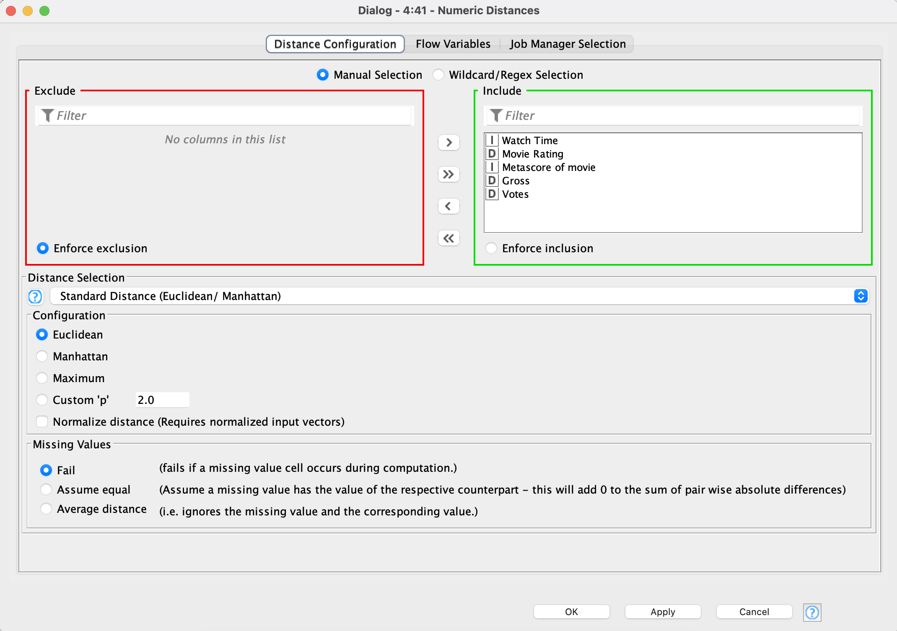
DBSCAN

Slide 21
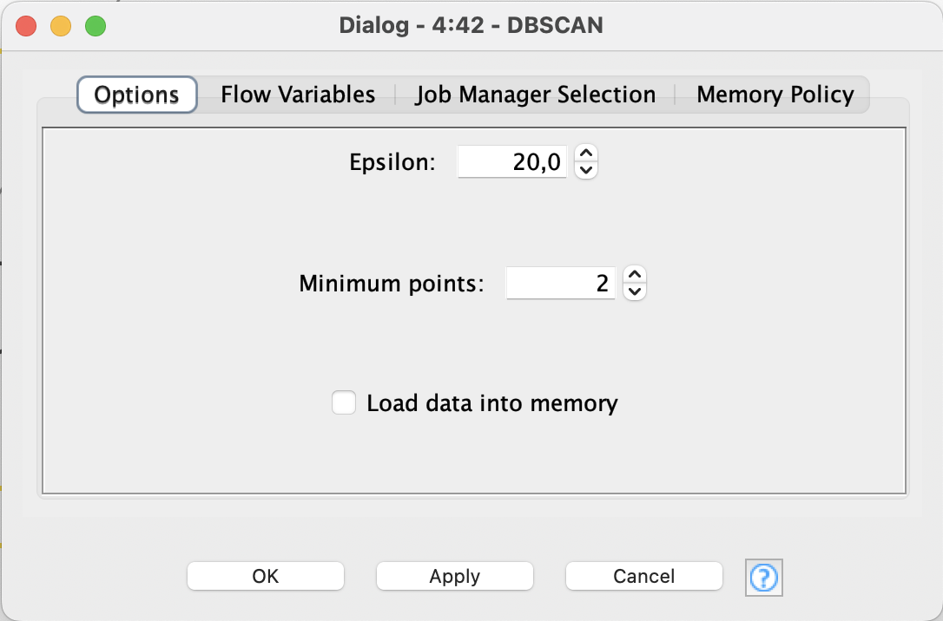
DBSCAN

Slide 22
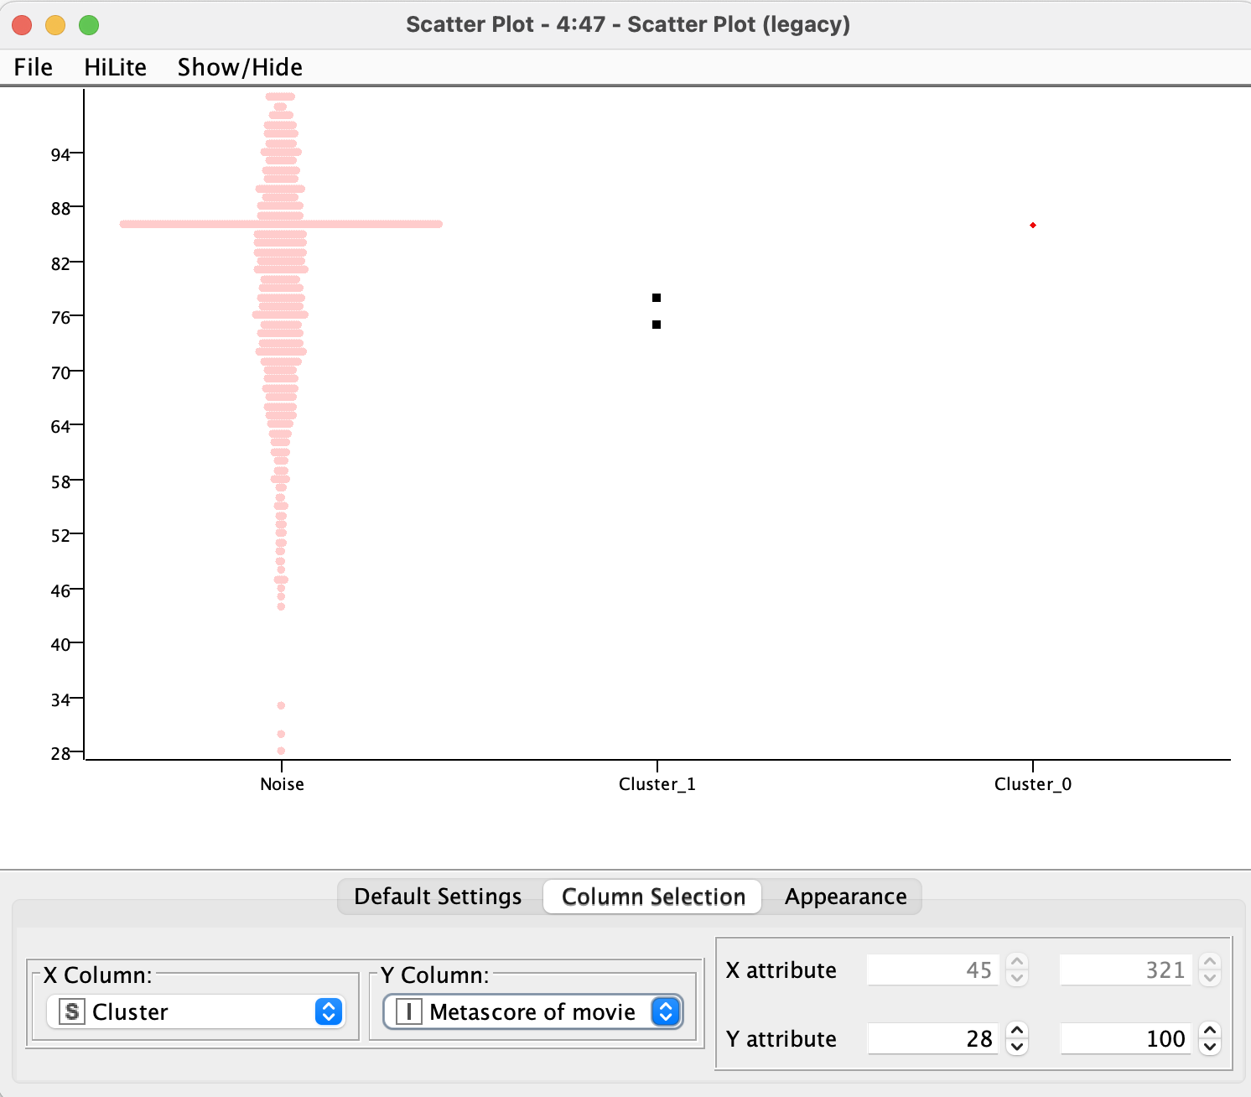
DBSCAN
Scatter Plot (legacy)
(Cluster-Metascore of movie)

Slide 23
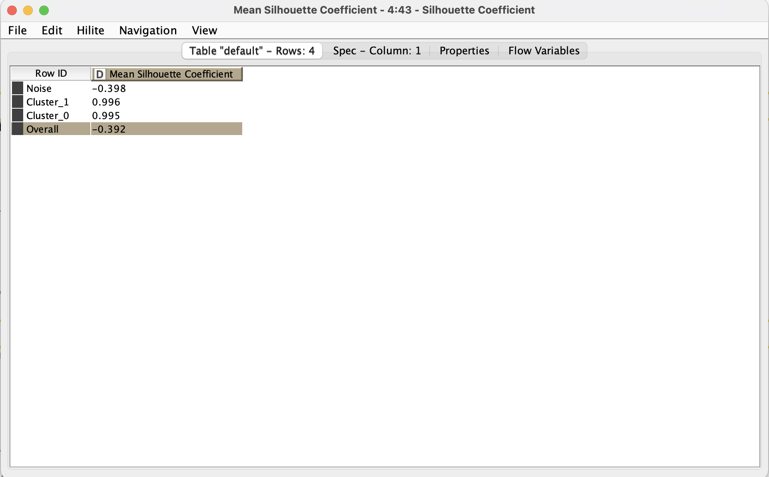
DBSCAN

Slide 24
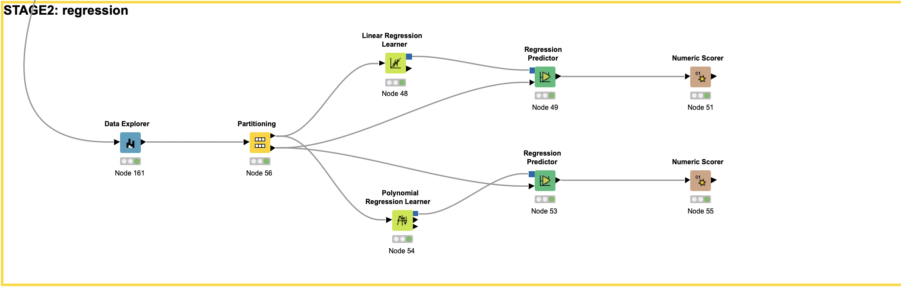
Regression

Slide 25
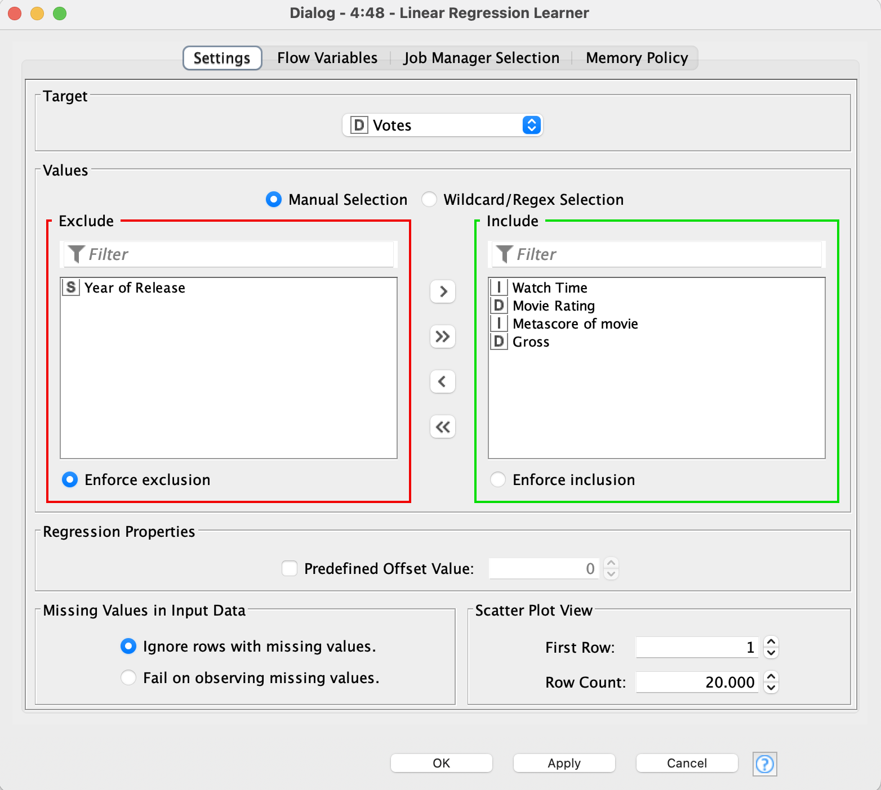
Regression

Slide 26
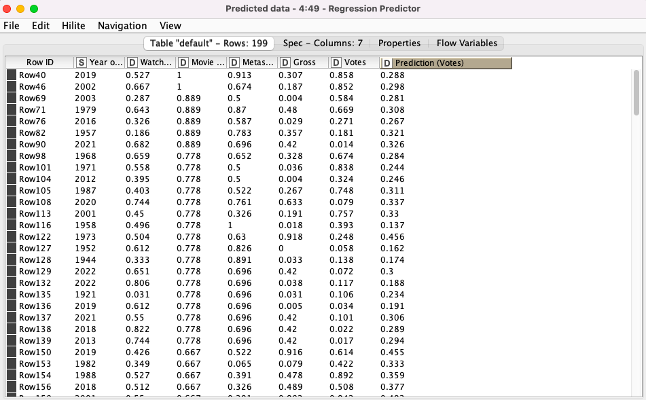
Regression

Slide 27
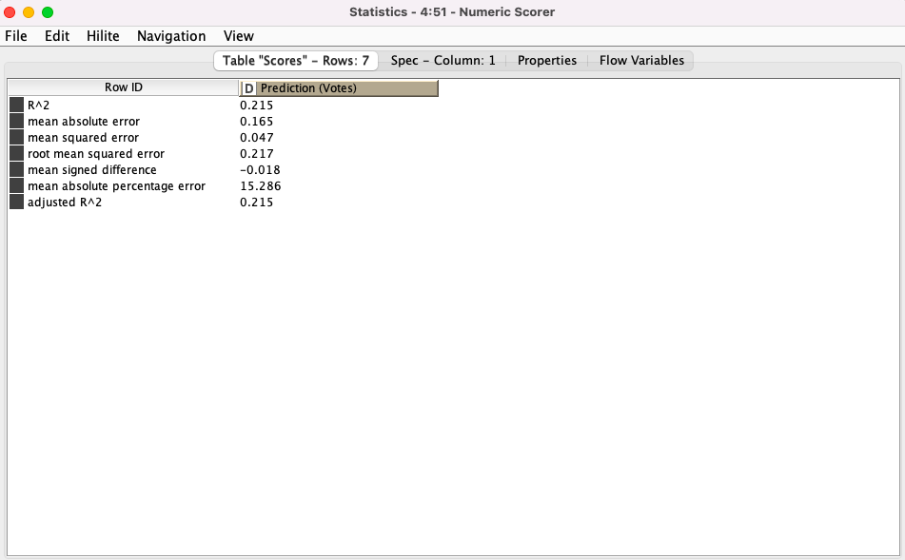
Regression

Slide 28
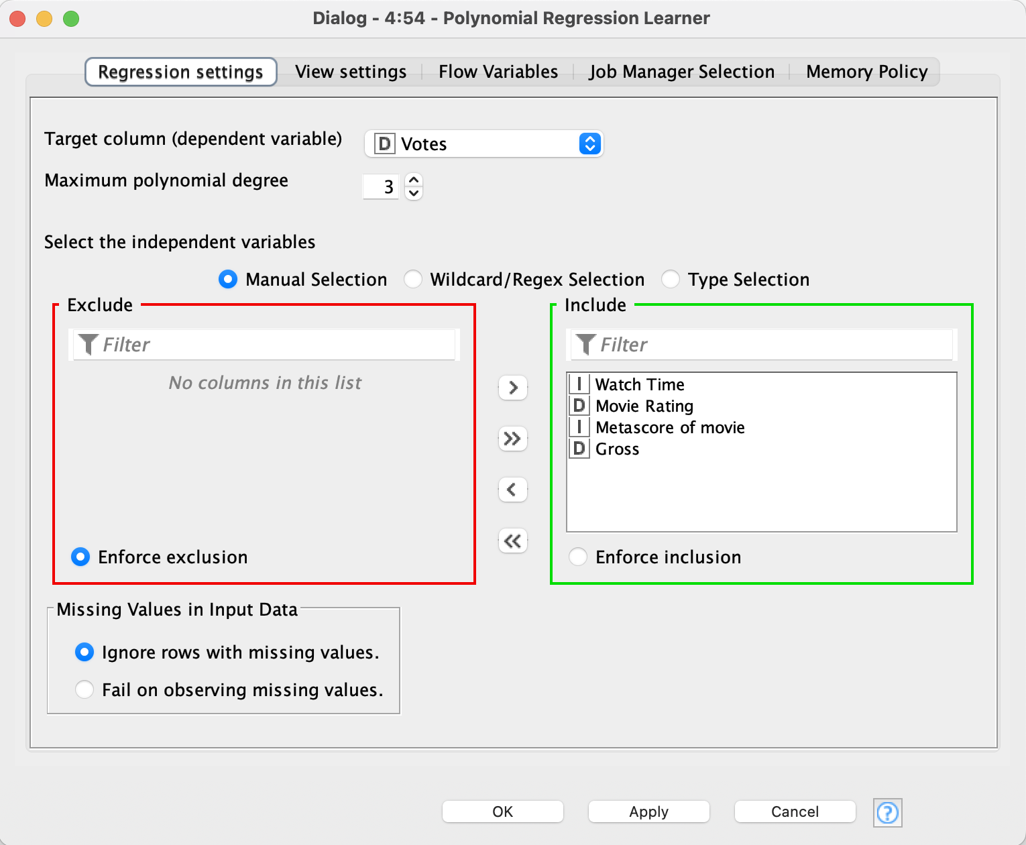
Regression

Slide 29

Regression

Slide 30
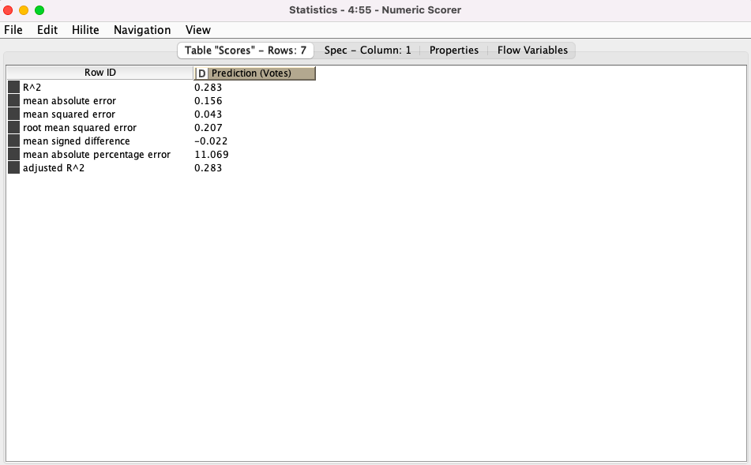
Regression

Slide 31
THANK YOU FOR YOUR ATTENTION

